Slide 1
Signoraware Advertisements Agency Recommendations

Slide 2
Consumers do not buy products, they buy product benefits.
-David Ogilvy

Slide 3
SAFE. HEALTHY. RECYCLABLE.
1

Slide 4
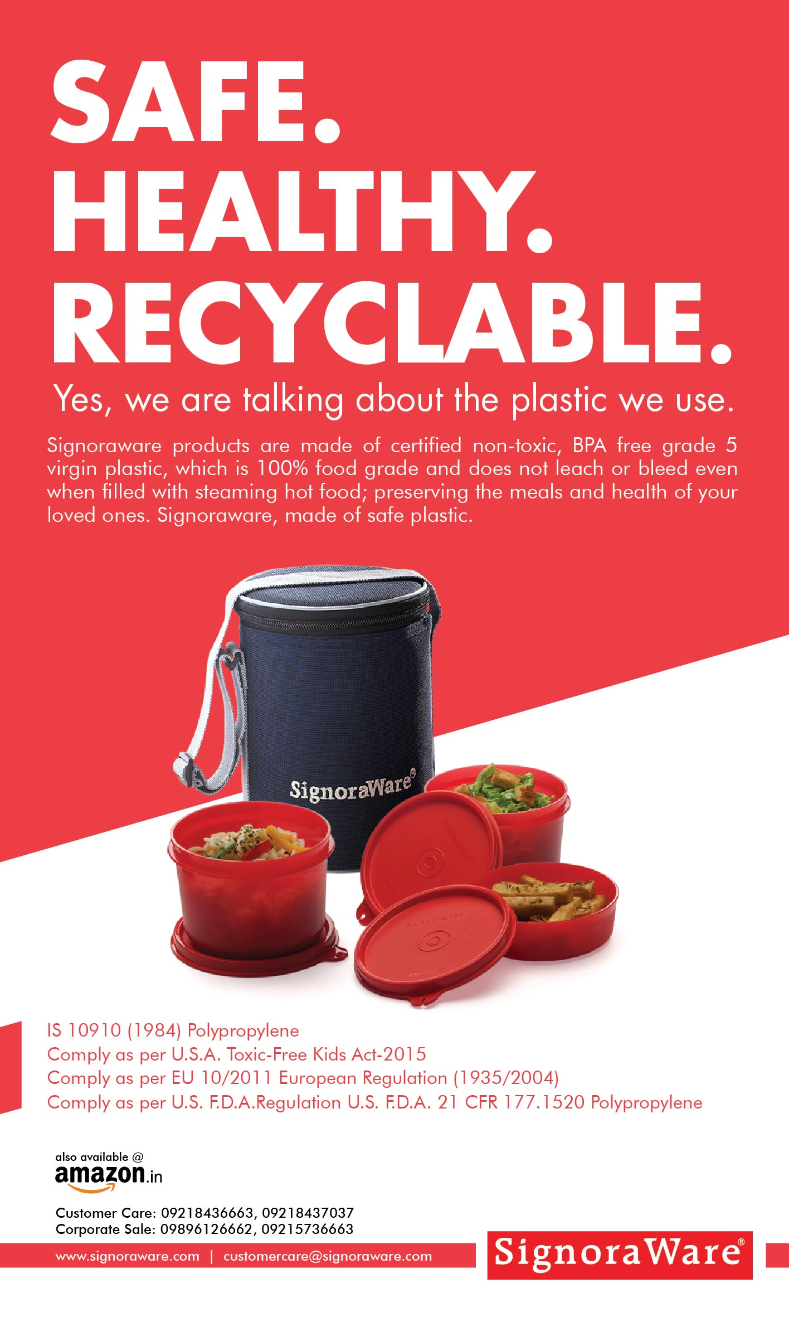
The advertisement talks of the words that people normally don’t hear associated with plastic. As new as it might sound, we give them reasons in our body copy to prove our credentials when we make the claim about the type of plastic that we use to manufacture our products.

Slide 5
ARE YOUR FOOD CONTAINERS SAFE?
2

Slide 6
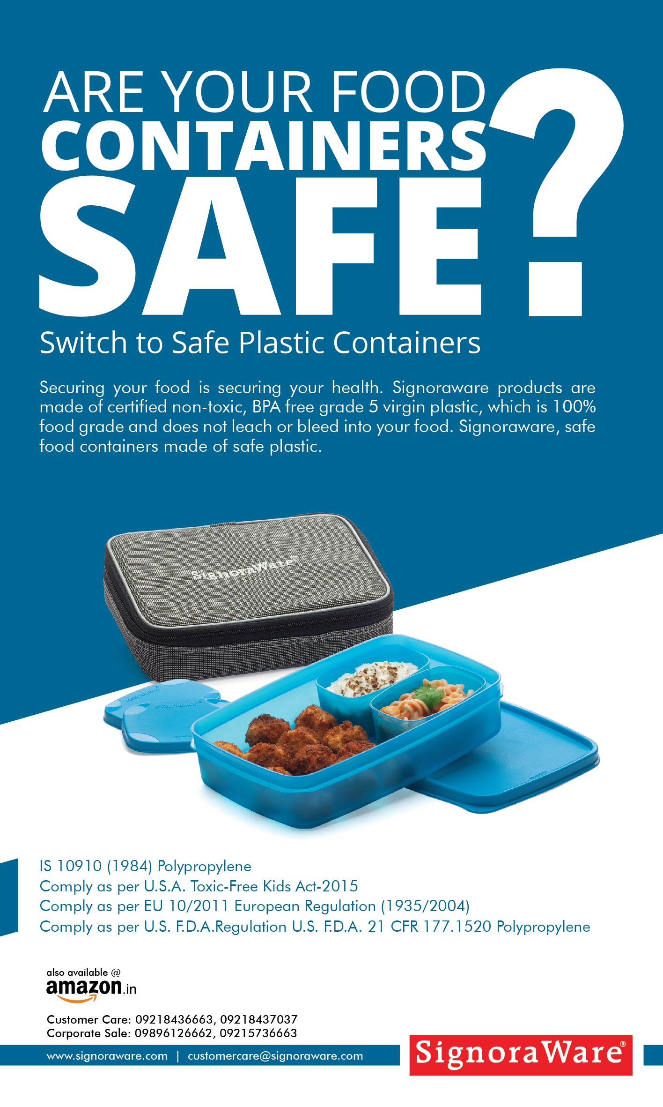
It interacts with the viewer and questions them about the type of food containers they have been using, the body copy also offers a solution in the form of Signoraware products; hence, completeing the communication.
Also, the question mark grabs attention and the layout is attractive and clean.

Slide 7
CHANGE FOR BETTER HEALTH. SWITCH TO SAFE PLASTIC.
3

Slide 8
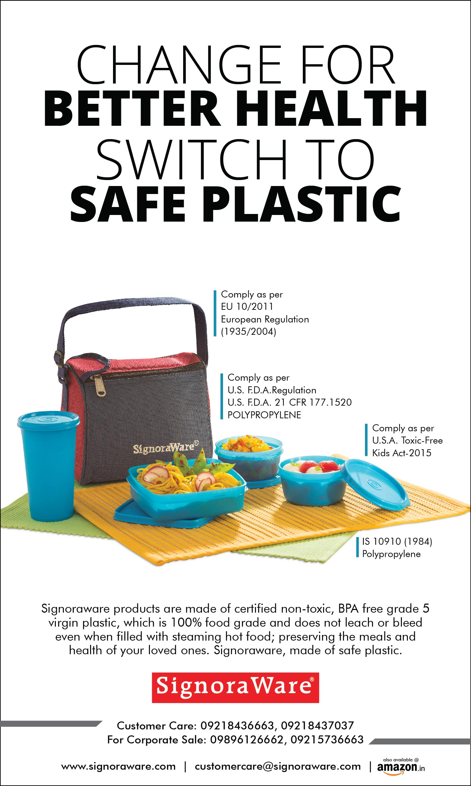
The headline calls for a change in the lifestyle of the viewer and talk about ‘better health’ by using Signoraware products made of SAFE plastic.
The body copy justifies the head and tells how our plastic does not leach and bleed even when filled with steaming hot food.
Again, the layout is clean and passes its message subtly yet powerfully.

Slide 9
In Advertising, not to be different is virtual suicide.

Slide 10
KEEP YOUR FOOD ALIVE.
4

Slide 11
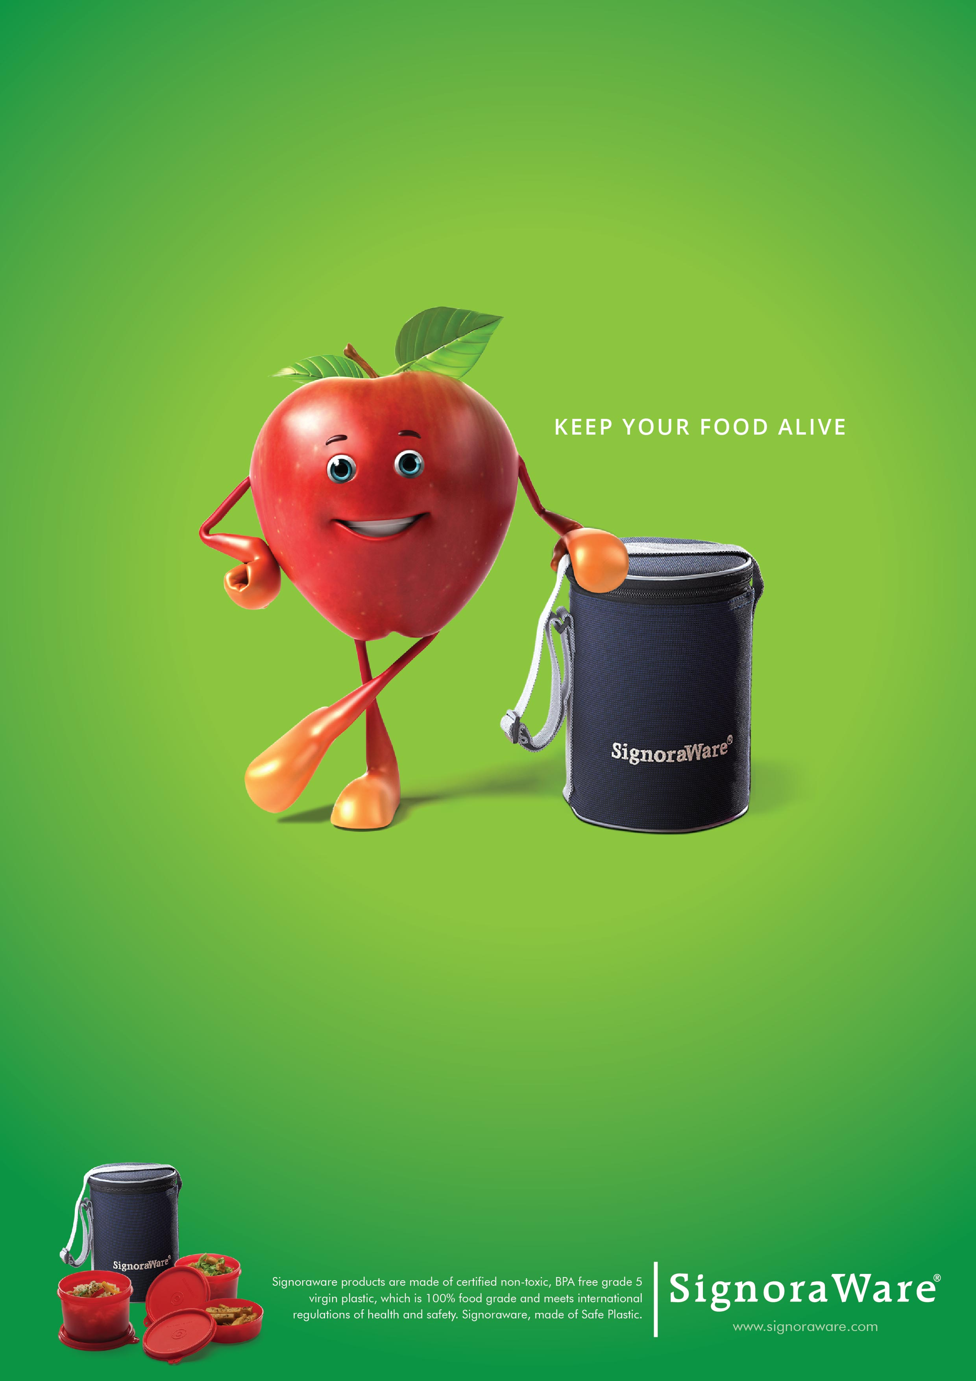
This ad takes the path less travelled by Signoraware so far. It is quirky, positive and most importantly, brings a smile to the face of the viewer. It is perfect for a magazine ad where the colors would look natural.
It incorporates the idea of Signoraware keeping your food gresh, happpy and alive for a long time and the body copy tells how.

Slide 12
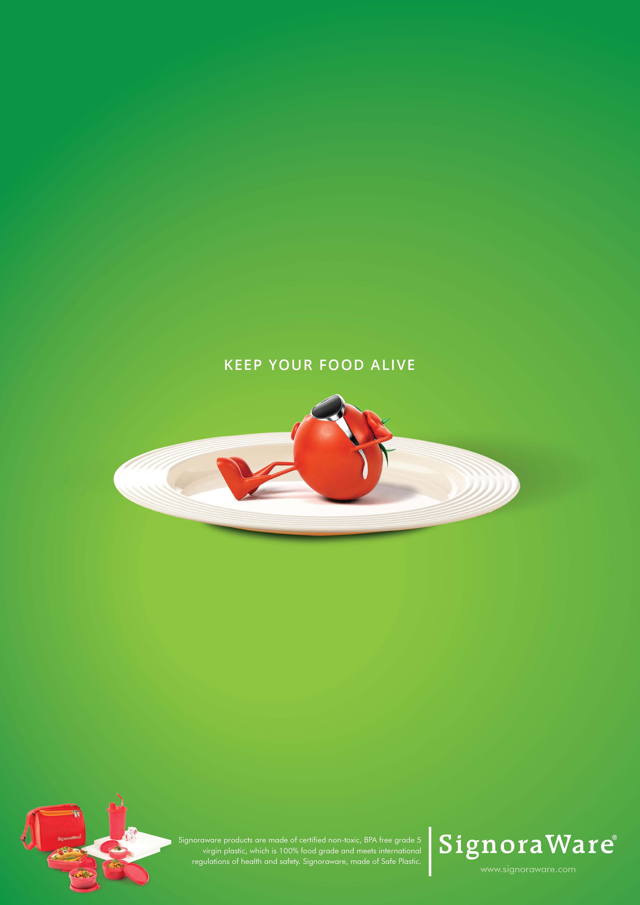
Creative 2.

Slide 13
Also, these are perfect for Digital and Social Media communication.
Place your screenshot here

Slide 14
Also, these are perfect for Digital and Social Media communication.
Place your screenshot here

Slide 15
Thanks!

